Slide 1
Addition and subtraction representations
Addition
+
=
Part
Part
Whole
Part
Part
Part
+
Part
Part
Part
Whole
Whole
Whole

Slide 2
Subtraction
-
=
Whole
Part
Part
Whole
Part
Part
-
Part
Part
Part
Part
Whole
Whole

Slide 3
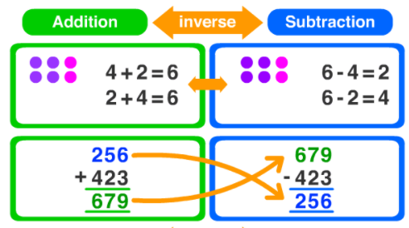
Checking Strategies
Addition and subtraction are the inverse of each other. Addition reversed subtraction and subtraction reverses addition. Because of this we can use addition to check subtraction calculations and we can use subtraction to check addition calculations.
Can you see the fact family?

Slide 4
So, let’s check this addition, using a subtraction calculation:
John has carried out this addition:
To check this we can use one of two subtractions:
or
+
=
Part
Part
Whole
+
=
12
5
18
-
=
If john’s addition is correct, this part would equal 5
Whole
Part
Part
-
=
18
12
6
If john’s addition is correct, this part would equal 12
-
=
18
5
13
So John’s addition is incorrect: 12 + 5 = 17 not 18

Slide 5
Now, let’s check this subtraction, using an addition calculation:
18 9
-
=
-
Whole
Part
Part
176
-
=
189
176
13
1 3
We can check this using one of two additions:
or
176
+
=
+
1 3
Part
Part
Whole
+
=
189
176
13
189
If john’s subtraction is correct, the whole would equal 189
1 3
+
176
+
=
189
13
176
189
So John’s subtraction is correct 

