Slide 1
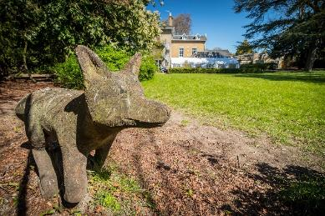
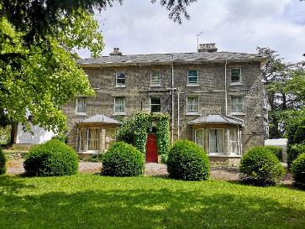
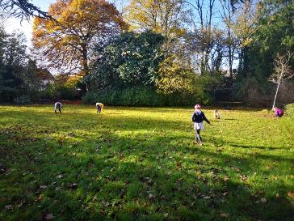
Welcome Home
Notes:
…because one of the most important things about our Centre is that it will feel like the home that it once was. This comes from the nature of the property (no soulless institution this!) and from the staff – who are lovely!

Slide 2
Why is this visit important?
“The first-hand experiences of learning outside the classroom can help to make subjects more vivid and interesting for pupils and enhance their understanding.” Ofsted
The Council for Learning Outside the Classroom (CLOTC) recognises that Learning outside the classroom:
  gives children new and exciting experiences that inspire them to reach their true potential.
  serves to re-motivate children who do not thrive in the traditional classroom environment
  encourages children to become more engaged in their education both inside and outside the classroom walls.
  increases self esteem, confidence, confidence and results – a proven link between high quality residentials and achievement.
“Trips help us to learn more stuff than we can in the classroom.”
(Primary pupil, Ofsted)
Notes:
Ofsted place real (and increasing ) value on well planned residential and off-site learning visits.
There are very clear (and proven) links between LOTC and motivation, engagement, self esteem, confidence, results. It is worth it.

Slide 3
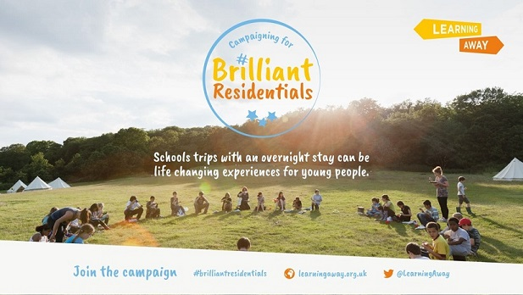
Why is this visit important (part 2)
“A residential learning experience provides opportunities, benefits and impacts that cannot be achieved in any other educational
context or setting.”
Learning Away report, 2016
Notes:
Overwhelming evidence that Residentials increase:
Attainment (results)
Engagement with learning,
Relationship (with other pupils and with staff),
Resilience and self confidence
Throughout whole trip, children encouraged to be responsible, respectful and given chance to work in teams

Slide 4
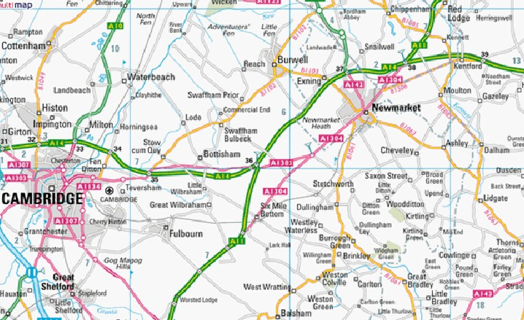
Where are we?
Notes:
Rural and tranquil, yet accessible. Village location approx. 10 minutes from A14, 10 miles from Cambridge.

Slide 5
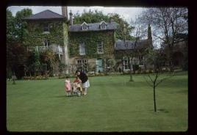
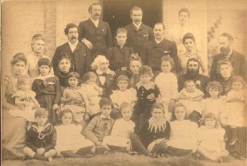
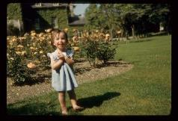
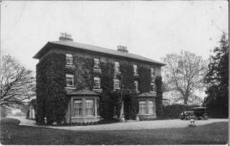
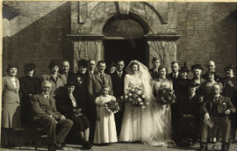
A family home, built in 1787…
…enjoyed for generations…
Notes:
Built by a local MP and landowner in 1787. Passed through and enjoyed by many generations of many families – a happy house. oozing w.ith character and warmth

Slide 6
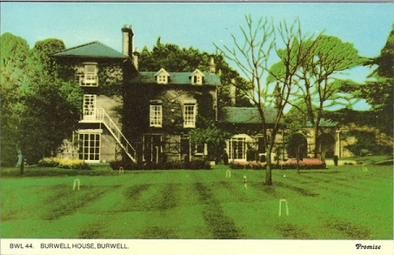
1964. A new purpose…
Bought by Cambridgeshire County Council for £15,000 to be enjoyed for generations to come.
Notes:
What a bargain!
First visitors were a group of Russian exchange students in June 1965.

Slide 7
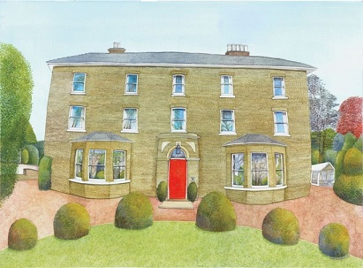
Today
Burwell House welcomes around 80 primary schools on residential visits each year, from right across East Anglia, and beyond.
Along with the wide variety of youth and adult groups who use the Centre at weekends and during the school holidays we host a total of 4000 visitors per year.
Schools staying with us have:
Sole residential occupancy – each school staying here will be the only school staying here.
Use of our fantastic house and its 3 acres of wonderful gardens.
Support from a caring, professional Centre staff team.
Freedom to plan a timetable that suits their curriculum, their topics and their individual children – our courses are built for your school.
Notes:
Many good reasons why schools choose to stay here, and many schools choose to do so.

Slide 8


High quality, accredited service
One of the 3 Centres within this partnership (Burwell House, Grafham Water Centre and Stibbington) all working together to bring learning to life for children from Cambridgeshire and beyond.
Awarded the LOTC quality badge in recognition of the high standards of safety, value and quality that our Centre provides.
Notes:
Quality badge assessment is a rigorous procedure

Slide 9
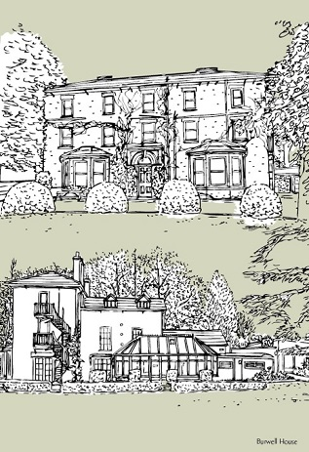
The House
No longer a family home - though all the staff strive to make it feel like one.
Grand, beautifully decorated, comfortable, warm, and homely.
Protected by modern, sensitive fire alarm system and sprinklers.
Secure – house is locked overnight by school staff, with grounds secured behind large wall and locked gates.
Notes:
Beautiful old house ( a real wow factor) but equipped with modern safety features and comforts.

Slide 10
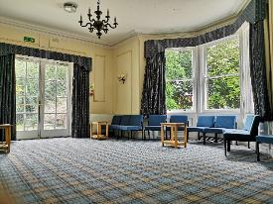
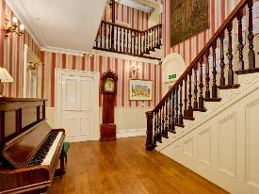
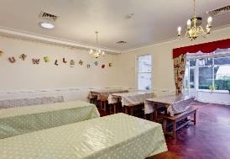
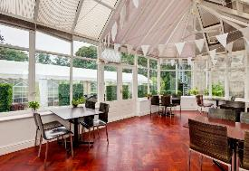
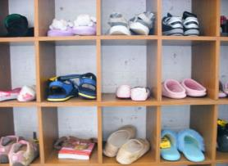
Downstairs
2 large lounges and a separate classroom.
Separate toilets for boys, girls and accompanying adults.
Cloakroom.
Dining room and conservatory
Notes:
The lounge is the main indoor base for schools, a comfortable base with room for the whole group to relax (contains TV, DVD)
A number of other downstairs spaces.
Additional room available as downstairs bedroom with accessible facilities if required.

Slide 11
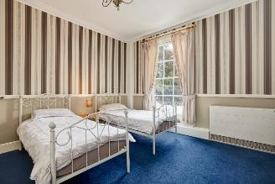
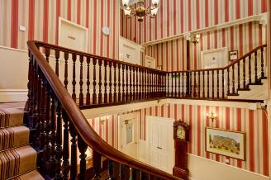
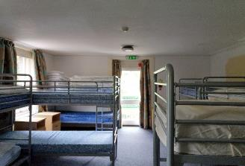
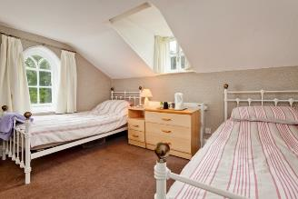
Upstairs
11 bedrooms in total, of various different shapes and sizes.
All with close access to their own shower and toilet facilities.
Notes:
Children’s rooms are nearby to adults rooms.
7 children’s bedrooms (containing 4 – 14 beds),
Each room has a sink, and either en-suite shower and toilet facilities or very nearby
Rooms have mainly bunk beds – all bedding is provided (not feather).
Children need to bring own towels & wash kit
School staff allocate children to each room.

Slide 12
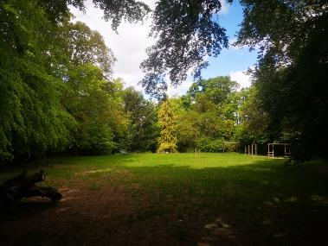
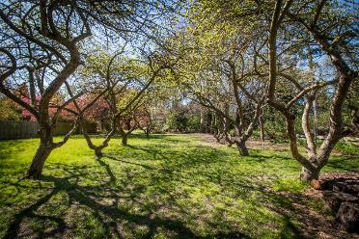
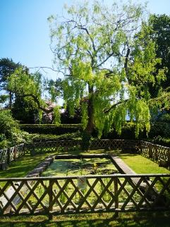
The gardens
3 acres of secure, inspiring, exciting, magical space for children to play, learn, explore, invent, have fun and let off steam.
Notes:
Whatever the time of year, the gardens are a great asset - Three acres of landscaped gardens
Offer relaxed, informal setting – lots of sculptures and fun things to discover, and a wildlife haven (deer, birds, hedgehogs)
Secure and safe walled grounds.
Children will play & explore during their free time.

Slide 13
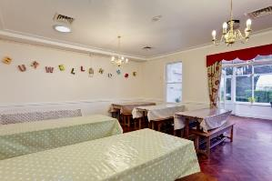
The food
“Food was fantastic. The kitchen staff were fantastic in the way they helped with our special diets”
“Excellent food, lots of it, special diets catered for”
“Thank you so much for all your care and attention. You made us all feel very looked after.”
“Quality of food exceptional”
“Lovely food. All the children and adults enjoyed”
“Very tasty! Children tried things they hadn't eaten before”
Continental breakfast and 2 home cooked hot meals per day.
Served ‘family’ style in the bright and fresh environment of our dining room and conservatory.
Special diets catered for.
Notes:
Breakfast, dinner & tea all served in dining room
Sit in small “family” table groups
Children fully involved in serving each other, clearing away & setting up for the next meal
Burwell House has good reputation for delicious, healthy food.
Refreshments served mid-morning (with biscuit) / afternoon (with fruit)
Special diets catered for.
We encourage all children to give things a try – and very regularly find that in the supportive environment amongst their friends, that children will give things a go. But we’ll always have an alternative if they absolutely refuse – we aren’t going to let any child go hungry!
Cooks enjoy making birthdays special - Home-made birthday cakes provided if needed.

Slide 14
Activities
Typical schedule
7:45 Wake up
8:30 Breakfast
9:30 Activity session 1
11.00 Morning refreshments + playtime
11.30 Activity session 2
13:00 Lunch
14.30 Activity session 3
16.00 Afternoon refreshments + playtime
16.30 Activity session 4
18:00 Dinner
19:00 School-led activities
e.g. diaries, shop, games
??? Bed time (at teachers’ discretion !!)
Wide variety of activities to choose from. Create, Explore and Investigate.
Schools have complete control over the timetable, with individually tailored timetables designed taking into account time of year, curriculum, topic and individual learner needs.
Plenty of indoor and outdoor options…though there’s no such thing as bad weather, only a bad choice of clothes (we do try to go ahead with things in rain, sleet and snow)
Notes:
Wide variety of options
Activity programme individually planned with school staff
Adapted to individual requirements of school
Activities linked to National Curriculum
Aim to enhance / extend classroom learning
Sample timetable sets out the way a day is normally planned out.

Slide 15
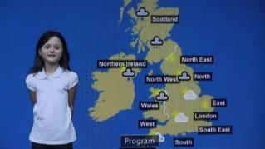
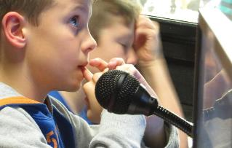
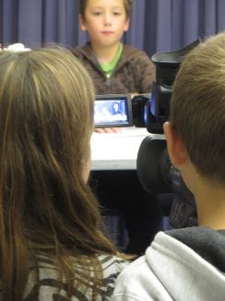
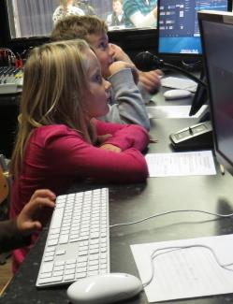
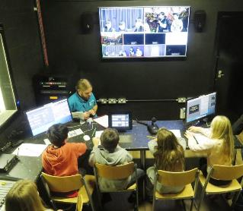
Create
TV Studio
A wonderful computing, literacy and teambuilding experience
Children work very closely together in teams to plan, write, film and produce programmes in our fabulous TV studio.
Notes:
Unique feature = fully-equipped TV studio
Children plan & produce a studio-style show. All children will perform, and be part of a technical ‘behind the scenes’ team – Director, Camera Operator etc.
Fantastic teambuilding, as well as wonderful literacy – speaking, listening and writing and IT.
Achieve great sense of satisfaction – final performances are recorded onto USB stick to be taken back to school.

Slide 16
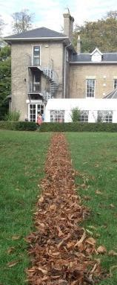
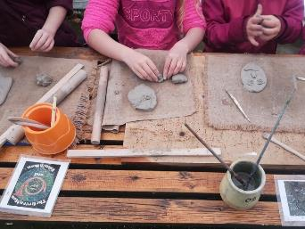
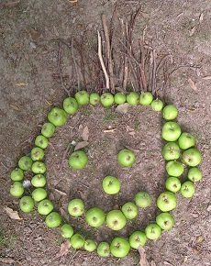
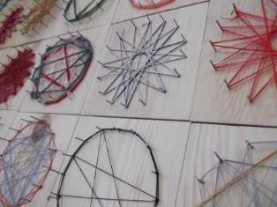
Create
Art and craft
A number of different options for children to express their creativity
Notes:
Activities include many which might not be possible at school - batik, clay, enamelling, hammer and nail art, great environment for natural art.
Children exercise their artist talents & produce treasured souvenir

Slide 17
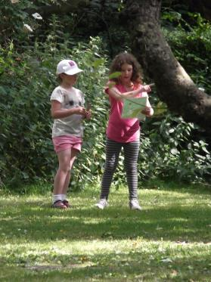
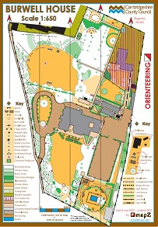
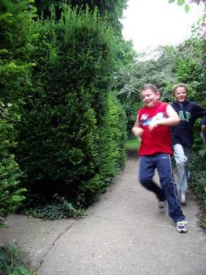
Explore
“The children worked exceptionally well together, particularly those who have never really engaged with each other”
Mapwork and Orienteering
A range of activities to learn and develop a variety of mapwork skills in and around the garden and out into the village and local area.
Notes:
An excellent garden for learning about and developing mapwork skills (far superior to very familiar school grounds)
Variety of trails around the garden, designed to practice different map skills.
Additional mapwork opportunities in and around Burwell and the local area.

Slide 18
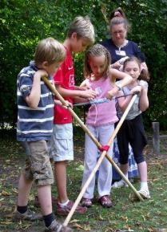
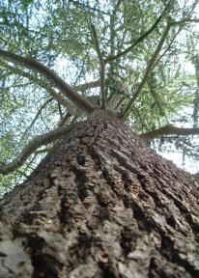
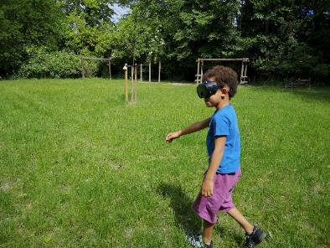
Explore
A range of activities designed to help children explore their surroundings, explore the environment, and to explore their own skills and abilities – working independently and in teams.
“They have been given such a range of opportunities to use their group work skills. Every child has had a chance to shine out through the wide range of activity types.”
Notes:
Explore the environment (bushcraft, sensory games, den building,)and explore your own abilities (through teambuilding, sensory games etc)
Team building is at the heart of every course through all of the activities at the Centre,

Slide 19
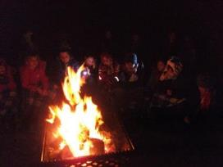
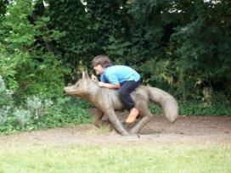
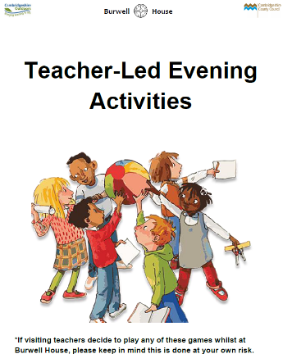
Evenings and overnight
House and grounds provide hours of fun and enjoyment – games, campfires, souvenir shop.
Sole group use – no other schools on site.
Secure accommodation.
Notes:
Run by school staff
Souvenir shop
Diaries, free time, bat detectors, play piano, games, campfire, stargazing.

Slide 20
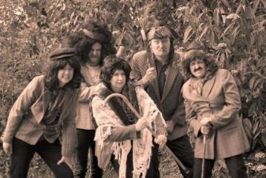
Our staff
Qualified, experienced, professional, caring – and just a little bit silly.
“Edd was great. He was patient and gentle with the children, and got the best out of them, whatever their skills and needs.”
“Jane was a great leader. She engaged really well with the children and led the sessions really well”
“Toni was fantastic! Organised, enthusiastic, creative and fun.
The children will treasure these memories for years to come”
“IMOGEN IS AWESOME! We appreciated it sooo much! She was (well is) wonderful with the children and always kept us updated & checked we were ok!“
Notes:
Qualified and experienced teachers – all who are excellent.
1 will coordinate and lead most of the teaching input
Get to know and interact with the children on an individual basis

Slide 21
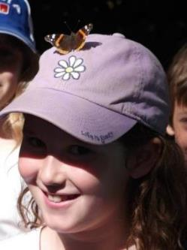
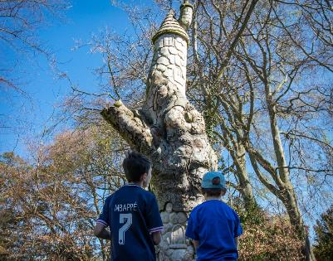
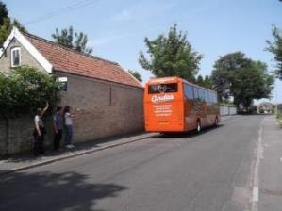
“This visit has been the most organised, enjoyable and fun residential trip we have ever been on. A huge thanks”
“Friendship, team building skills, table manners improved, tried new things.
Overall a really great first experience of being away from home for the children”
Notes:
Quotes and questions

