Slide 1
Monday 23rd November
Mrs Wordsmith

Slide 3
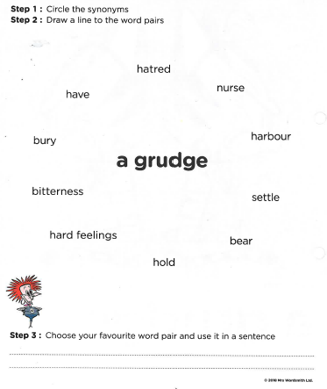

Slide 4
Tuesday 24th November
Mrs Wordsmith

Slide 6
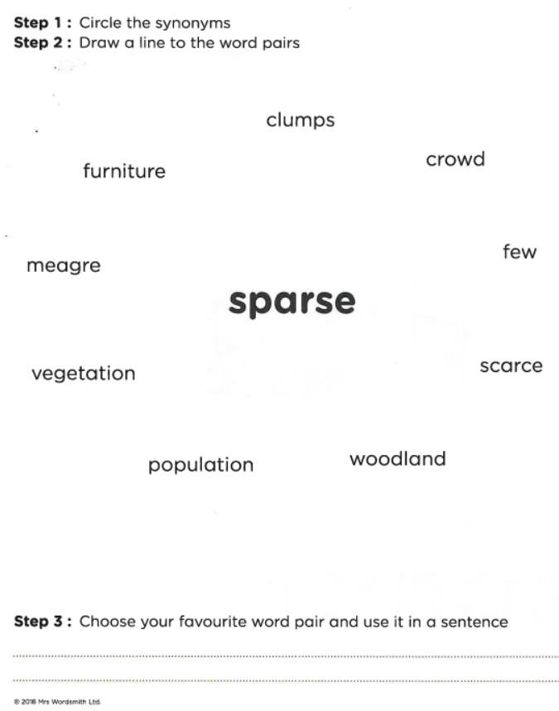

Slide 7
Wednesday 25th November
Use the words from Monday and Tuesday.
Draw a picture of what the word means.
Put the word in a sentence.

Slide 8
Thursday 26th November
Mrs Wordsmith

Slide 10
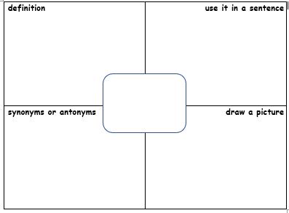

Slide 11
Friday 27th November
Complete the matching activity on the other document.
Link the word to the matching picture and to a word pair.

