Slide 1
Mastering Number at Key Stage 2
Parent/carer information
Notes:
).]

Slide 2


Learning multiplication facts to automaticity
Do you remember learning your tables? If you were to be asked some questions to test how good you remember them, how would it make you feel?
Which facts have stuck, and which do you still have to think about?
Notes:
Set the scene and get some reflection about their own learning experiences. For pupils that do not know their tables facts –they end up doing the more complicated maths because they have to work out the fact as well as the question that it is applied to.

Slide 3
Learning multiplication facts to automaticity
Does your child ever:
hesitate, look around for inspiration or think a long time before having a go to retrieve a fact;
skip count to work them out;
say that they just do not know them?
As a school we are engaged in the Mastering Number at KS2 programme.
The aim is for ALL pupils to secure multiplication facts to automaticity. The fact just pops into their head – no hesitation!
Your support in this is essential and would be greatly appreciated.
Notes:
Stress ALL pupils – there are no exceptions.

Slide 4
Mastering Number at KS2
Year 4 into Year 5
Year 4
Sessions focus on multiplication fact retrieval alongside conceptual and structural understanding of the multiplicative relationship
Year 5
Sessions still focus on fact retrieval – more opportunities to connect multiplication to division facts and making further conceptual connections
Notes:
If a pupil struggles with retrieval – products are only there because derivation is the only strategy will not support them in the long term.
If you skip count for example, it takes time, and you are not seeing the relationship between the factors and the product.
You could find it more difficult to make connections to division, to fractions, to ratio – all aspects that are part of the maths curriculum in KS2.

Slide 5
Fluency
Information processing theory suggests that the basic math facts should be known so well as to be unconsciously available. In this way a student can have more cognitive resources free for understanding and performing increasingly complex mathematical chores (Caron, 2007; Poncy et al., 2006; Ramos-Christian, Schleser, & Varn, 2008; Woodward, 2006).
Notes:
Summarise – your brain can focus on the maths problem rather than working out a fact that is needed within it.

Slide 6
What is different about the way we support pupils to learn facts in Mastering Number at KS2?
We do not learn sets of facts such as the 5-times table. We learn just two facts a week in sessions called Going for Gold.
We just say three numbers, we do not say ‘times’, ‘multiplied by’,… so for this fact 5 × 9 = 45, we just say 5, 9, 45.
9 × 5 = 45, we say 5, 9, 45 for this fact as well!
Notes:
Some will say that their child already has learnt their tables – say that this programme will support them to secure facts in a random order.

Slide 7
GOING FOR GOLD

Slide 8

I think there are 144 DIFFERENT facts to learn altogether!
Do you agree with Mo?
1 × 1 | 2 × 1 | 3 × 1 | 4 × 1 | 5 × 1 | 6 × 1 | 7 × 1 | 8 × 1 | 9 × 1 | 10 × 1 | 11 × 1 | 12 × 1
1 × 2 | 2 × 2 | 3 × 2 | 4 × 2 | 5 × 2 | 6 × 2 | 7 × 2 | 8 × 2 | 9 × 2 | 10 × 2 | 11 × 2 | 12 × 2
1 × 3 | 2 × 3 | 3 × 3 | 4 × 3 | 5 × 3 | 6 × 3 | 7 × 3 | 8 × 3 | 9 × 3 | 10 × 3 | 11 × 3 | 12 × 3
1 × 4 | 2 × 4 | 3 × 4 | 4 × 4 | 5 × 4 | 6 × 4 | 7 × 4 | 8 × 4 | 9 × 4 | 10 × 4 | 11 × 4 | 12 × 4
1 × 5 | 2 × 5 | 3 × 5 | 4 × 5 | 5 × 5 | 6 × 5 | 7 × 5 | 8 × 5 | 9 × 5 | 10 × 5 | 11 × 5 | 12 × 5
1 × 6 | 2 × 6 | 3 × 6 | 4 × 6 | 5 × 6 | 6 × 6 | 7 × 6 | 8 × 6 | 9 × 6 | 10 × 6 | 11 × 6 | 12 × 6
1 × 7 | 2 × 7 | 3 × 7 | 4 × 7 | 5 × 7 | 6 × 7 | 7 × 7 | 8 × 7 | 9 × 7 | 10 × 7 | 11 × 7 | 12 × 7
1 × 8 | 2 × 8 | 3 × 8 | 4 × 8 | 5 × 8 | 6 × 8 | 7 × 8 | 8 × 8 | 9 × 8 | 10 × 8 | 11 × 8 | 12 × 8
1 × 9 | 2 × 9 | 3 × 9 | 4 × 9 | 5 × 9 | 6 × 9 | 7 × 9 | 8 × 9 | 9 × 9 | 10 × 9 | 11 × 9 | 12 × 9
1 × 10 | 2 × 10 | 3 × 10 | 4 × 10 | 5 × 10 | 6 × 10 | 7 × 10 | 8 × 10 | 9 × 10 | 10 × 10 | 11 × 10 | 12 × 10
1 × 11 | 2 × 11 | 3 × 11 | 4 × 11 | 5 × 11 | 6 × 11 | 7 × 11 | 8 × 11 | 9 × 11 | 10 × 11 | 11 × 11 | 12 × 11
1 × 12 | 2 × 12 | 3 × 12 | 4 × 12 | 5 × 12 | 6 × 12 | 7 × 12 | 8 × 12 | 9 × 12 | 10 × 12 | 11 × 12 | 12 × 12
Notes:
This is a slide from the materials – we do not need to learn all of these!

Slide 9
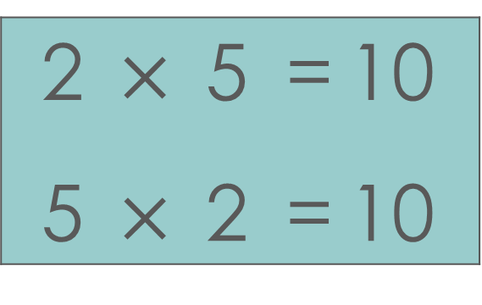
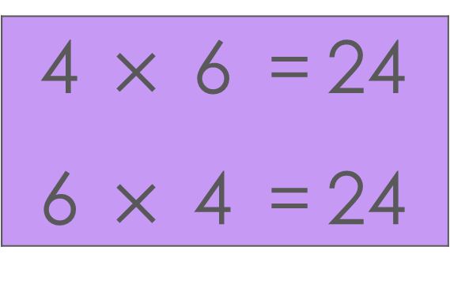
What do you notice about each pair of equations?
2 | $×$ | 5 | = | 10
5 | $×$ | 2 | = | 10
4 | $×$ | 6 | = | 24
6 | $×$ | 4 | = | 24
Notes:
The same product – the factors are written in a different order.

Slide 10
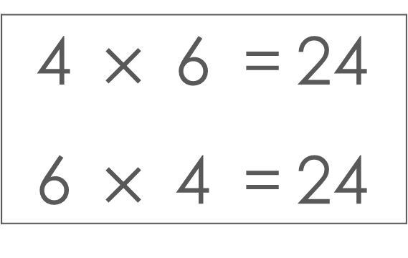
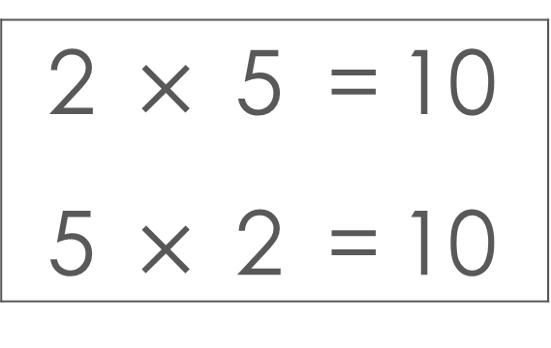
Complete the missing words in the sentence.
This means that there are far fewer facts I need to learn!
2 | $×$ | 5 | = | 10
5 | $×$ | 2 | = | 10
4 | $×$ | 6 | = | 24
6 | $×$ | 4 | = | 24
When the order of the ________ is changed, the ________ remains the same.
factors
product

Slide 11
There are 78 facts to learn!
Let’s take out the facts that are repeated!
1 × 1 | 2 × 1 | 3 × 1 | 4 × 1 | 5 × 1 | 6 × 1 | 7 × 1 | 8 × 1 | 9 × 1 | 10 × 1 | 11 × 1 | 12 × 1
1 × 2 | 2 × 2 | 3 × 2 | 4 × 2 | 5 × 2 | 6 × 2 | 7 × 2 | 8 × 2 | 9 × 2 | 10 × 2 | 11 × 2 | 12 × 2
1 × 3 | 2 × 3 | 3 × 3 | 4 × 3 | 5 × 3 | 6 × 3 | 7 × 3 | 8 × 3 | 9 × 3 | 10 × 3 | 11 × 3 | 12 × 3
1 × 4 | 2 × 4 | 3 × 4 | 4 × 4 | 5 × 4 | 6 × 4 | 7 × 4 | 8 × 4 | 9 × 4 | 10 × 4 | 11 × 4 | 12 × 4
1 × 5 | 2 × 5 | 3 × 5 | 4 × 5 | 5 × 5 | 6 × 5 | 7 × 5 | 8 × 5 | 9 × 5 | 10 × 5 | 11 × 5 | 12 × 5
1 × 6 | 2 × 6 | 3 × 6 | 4 × 6 | 5 × 6 | 6 × 6 | 7 × 6 | 8 × 6 | 9 × 6 | 10 × 6 | 11 × 6 | 12 × 6
1 × 7 | 2 × 7 | 3 × 7 | 4 × 7 | 5 × 7 | 6 × 7 | 7 × 7 | 8 × 7 | 9 × 7 | 10 × 7 | 11 × 7 | 12 × 7
1 × 8 | 2 × 8 | 3 × 8 | 4 × 8 | 5 × 8 | 6 × 8 | 7 × 8 | 8 × 8 | 9 × 8 | 10 × 8 | 11 × 8 | 12 × 8
1 × 9 | 2 × 9 | 3 × 9 | 4 × 9 | 5 × 9 | 6 × 9 | 7 × 9 | 8 × 9 | 9 × 9 | 10 × 9 | 11 × 9 | 12 × 9
1 × 10 | 2 × 10 | 3 × 10 | 4 × 10 | 5 × 10 | 6 × 10 | 7 × 10 | 8 × 10 | 9 × 10 | 10 × 10 | 11 × 10 | 12 × 10
1 × 11 | 2 × 11 | 3 × 11 | 4 × 11 | 5 × 11 | 6 × 11 | 7 × 11 | 8 × 11 | 9 × 11 | 10 × 11 | 11 × 11 | 12 × 11
1 × 12 | 2 × 12 | 3 × 12 | 4 × 12 | 5 × 12 | 6 × 12 | 7 × 12 | 8 × 12 | 9 × 12 | 10 × 12 | 11 × 12 | 12 × 12
1 × 1
1 × 2 | 2 × 2
1 × 3 | 2 × 3 | 3 × 3
1 × 4 | 2 × 4 | 3 × 4 | 4 × 4
1 × 5 | 2 × 5 | 3 × 5 | 4 × 5 | 5 × 5
1 × 6 | 2 × 6 | 3 × 6 | 4 × 6 | 5 × 6 | 6 × 6
1 × 7 | 2 × 7 | 3 × 7 | 4 × 7 | 5 × 7 | 6 × 7 | 7 × 7
1 × 8 | 2 × 8 | 3 × 8 | 4 × 8 | 5 × 8 | 6 × 8 | 7 × 8 | 8 × 8
1 × 9 | 2 × 9 | 3 × 9 | 4 × 9 | 5 × 9 | 6 × 9 | 7 × 9 | 8 × 9 | 9 × 9
1 × 10 | 2 × 10 | 3 × 10 | 4 × 10 | 5 × 10 | 6 × 10 | 7 × 10 | 8 × 10 | 9 × 10 | 10 × 10
1 × 11 | 2 × 11 | 3 × 11 | 4 × 11 | 5 × 11 | 6 × 11 | 7 × 11 | 8 × 11 | 9 × 11 | 10 × 11 | 11 × 11
1 × 12 | 2 × 12 | 3 × 12 | 4 × 12 | 5 × 12 | 6 × 12 | 7 × 12 | 8 × 12 | 9 × 12 | 10 × 12 | 11 × 12 | 12 × 12
1 × 1
1 × 2 | 2 × 2
1 × 3 | 2 × 3 | 3 × 3
1 × 4 | 2 × 4 | 3 × 4 | 4 × 4
1 × 5 | 2 × 5 | 3 × 5 | 4 × 5 | 5 × 5
1 × 6 | 2 × 6 | 3 × 6 | 4 × 6 | 5 × 6 | 6 × 6
1 × 7 | 2 × 7 | 3 × 7 | 4 × 7 | 5 × 7 | 6 × 7 | 7 × 7
1 × 8 | 2 × 8 | 3 × 8 | 4 × 8 | 5 × 8 | 6 × 8 | 7 × 8 | 8 × 8
1 × 9 | 2 × 9 | 3 × 9 | 4 × 9 | 5 × 9 | 6 × 9 | 7 × 9 | 8 × 9 | 9 × 9
1 × 10 | 2 × 10 | 3 × 10 | 4 × 10 | 5 × 10 | 6 × 10 | 7 × 10 | 8 × 10 | 9 × 10 | 10 × 10
1 × 11 | 2 × 11 | 3 × 11 | 4 × 11 | 5 × 11 | 6 × 11 | 7 × 11 | 8 × 11 | 9 × 11 | 10 × 11 | 11 × 11
1 × 12 | 2 × 12 | 3 × 12 | 4 × 12 | 5 × 12 | 6 × 12 | 7 × 12 | 8 × 12 | 9 × 12 | 10 × 12 | 11 × 12 | 12 × 12
Notes:
This is still too many to learn!

Slide 12
78 facts still seems a lot to learn…
Don’t worry! We know a lot already and some are really easy.
1 × 1
1 × 2 | 2 × 2
1 × 3 | 2 × 3 | 3 × 3
1 × 4 | 2 × 4 | 3 × 4 | 4 × 4
1 × 5 | 2 × 5 | 3 × 5 | 4 × 5 | 5 × 5
1 × 6 | 2 × 6 | 3 × 6 | 4 × 6 | 5 × 6 | 6 × 6
1 × 7 | 2 × 7 | 3 × 7 | 4 × 7 | 5 × 7 | 6 × 7 | 7 × 7
1 × 8 | 2 × 8 | 3 × 8 | 4 × 8 | 5 × 8 | 6 × 8 | 7 × 8 | 8 × 8
1 × 9 | 2 × 9 | 3 × 9 | 4 × 9 | 5 × 9 | 6 × 9 | 7 × 9 | 8 × 9 | 9 × 9
1 × 10 | 2 × 10 | 3 × 10 | 4 × 10 | 5 × 10 | 6 × 10 | 7 × 10 | 8 × 10 | 9 × 10 | 10 × 10
1 × 11 | 2 × 11 | 3 × 11 | 4 × 11 | 5 × 11 | 6 × 11 | 7 × 11 | 8 × 11 | 9 × 11 | 10 × 11 | 11 × 11
1 × 12 | 2 × 12 | 3 × 12 | 4 × 12 | 5 × 12 | 6 × 12 | 7 × 12 | 8 × 12 | 9 × 12 | 10 × 12 | 11 × 12 | 12 × 12
Mo
Cal
Notes:
Which ones would you confidently say that you know? How about your child?

Slide 13
Do you know these ones… ?
1 × 1
1 × 2 | 2 × 2
1 × 3 | 2 × 3 | 3 × 3
1 × 4 | 2 × 4 | 3 × 4 | 4 × 4
1 × 5 | 2 × 5 | 3 × 5 | 4 × 5 | 5 × 5
1 × 6 | 2 × 6 | 3 × 6 | 4 × 6 | 5 × 6 | 6 × 6
1 × 7 | 2 × 7 | 3 × 7 | 4 × 7 | 5 × 7 | 6 × 7 | 7 × 7
1 × 8 | 2 × 8 | 3 × 8 | 4 × 8 | 5 × 8 | 6 × 8 | 7 × 8 | 8 × 8
1 × 9 | 2 × 9 | 3 × 9 | 4 × 9 | 5 × 9 | 6 × 9 | 7 × 9 | 8 × 9 | 9 × 9
1 × 10 | 2 × 10 | 3 × 10 | 4 × 10 | 5 × 10 | 6 × 10 | 7 × 10 | 8 × 10 | 9 × 10 | 10 × 10
1 × 11 | 2 × 11 | 3 × 11 | 4 × 11 | 5 × 11 | 6 × 11 | 7 × 11 | 8 × 11 | 9 × 11 | 10 × 11 | 11 × 11
1 × 12 | 2 × 12 | 3 × 12 | 4 × 12 | 5 × 12 | 6 × 12 | 7 × 12 | 8 × 12 | 9 × 12 | 10 × 12 | 11 × 12 | 12 × 12
Notes:
The 1 times table should not need to be learnt but we do make sure that all pupils understand what it means to multiply by 1.

Slide 14
The ‘10s’ are easy too!
1 × 1
1 × 2 | 2 × 2
1 × 3 | 2 × 3 | 3 × 3
1 × 4 | 2 × 4 | 3 × 4 | 4 × 4
1 × 5 | 2 × 5 | 3 × 5 | 4 × 5 | 5 × 5
1 × 6 | 2 × 6 | 3 × 6 | 4 × 6 | 5 × 6 | 6 × 6
1 × 7 | 2 × 7 | 3 × 7 | 4 × 7 | 5 × 7 | 6 × 7 | 7 × 7
1 × 8 | 2 × 8 | 3 × 8 | 4 × 8 | 5 × 8 | 6 × 8 | 7 × 8 | 8 × 8
1 × 9 | 2 × 9 | 3 × 9 | 4 × 9 | 5 × 9 | 6 × 9 | 7 × 9 | 8 × 9 | 9 × 9
1 × 10 | 2 × 10 | 3 × 10 | 4 × 10 | 5 × 10 | 6 × 10 | 7 × 10 | 8 × 10 | 9 × 10 | 10 × 10
1 × 11 | 2 × 11 | 3 × 11 | 4 × 11 | 5 × 11 | 6 × 11 | 7 × 11 | 8 × 11 | 9 × 11 | 10 × 11 | 11 × 11
1 × 12 | 2 × 12 | 3 × 12 | 4 × 12 | 5 × 12 | 6 × 12 | 7 × 12 | 8 × 12 | 9 × 12 | 10 × 12 | 11 × 12 | 12 × 12
Notes:
The 10s times table should already be secure as well!

Slide 15
If we know the ‘1s’, ‘2s’ and ‘10s’, then we can work out the ‘11s’ and ‘12s’!
Take out the ‘1s’ and the ‘10s’… that leaves these facts to learn!
 | 2 × 2
 | 2 × 3 | 3 × 3
 | 2 × 4 | 3 × 4 | 4 × 4
 | 2 × 5 | 3 × 5 | 4 × 5 | 5 × 5
 | 2 × 6 | 3 × 6 | 4 × 6 | 5 × 6 | 6 × 6
 | 2 × 7 | 3 × 7 | 4 × 7 | 5 × 7 | 6 × 7 | 7 × 7
 | 2 × 8 | 3 × 8 | 4 × 8 | 5 × 8 | 6 × 8 | 7 × 8 | 8 × 8
 | 2 × 9 | 3 × 9 | 4 × 9 | 5 × 9 | 6 × 9 | 7 × 9 | 8 × 9 | 9 × 9
 | 2 × 11 | 3 × 11 | 4 × 11 | 5 × 11 | 6 × 11 | 7 × 11 | 8 × 11 | 9 × 11 | 10 × 11 | 11 × 11
 | 2 × 12 | 3 × 12 | 4 × 12 | 5 × 12 | 6 × 12 | 7 × 12 | 8 × 12 | 9 × 12 | 10 × 12 | 11 × 12 | 12 × 12
Mo
Cal
Notes:
Explain that we look at the 11 and 12s as these too can be easy to know.

Slide 16
We can learn 36 facts if we help each other!
These are the 36 core facts! Can you see any factors that are NOT 1-digit numbers?
2 × 2 = 4
2 × 3 = 6 | 3 × 3 = 9
2 × 4 = 8 | 3 × 4 = 12 | 4 × 4 = 16
2 × 5 = 10 | 3 × 5 = 15 | 4 × 5 = 20 | 5 × 5 = 25
2 × 6 = 12 | 3 × 6 = 18 | 4 × 6 = 24 | 5 × 6 = 30 | 6 × 6 = 36
2 × 7 = 14 | 3 × 7 = 21 | 4 × 7 = 28 | 5 × 7 = 35 | 6 × 7 = 42 | 7 × 7 = 49
2 × 8 = 16 | 3 × 8 = 24 | 4 × 8 = 32 | 5 × 8 = 40 | 6 × 8 = 48 | 7 × 8 = 56 | 8 × 8 = 64
2 × 9 = 18 | 3 × 9 = 27 | 4 × 9 = 36 | 5 × 9 = 45 | 6 × 9 = 54 | 7 × 9 = 72 | 8 × 9 = 72 | 9 × 9 = 81
Mo
Cal
Notes:
When 2 is a factor, we look at doubling – these facts should also be secure , but we spend time looking at them to make sure.

Slide 17
Please support your child to know to automaticity
Facts with:
1 as a factor × 1
2 as a factor × 2
10 as a factor × 10
factors that are the same square facts such as 7 × 7 = 49
Notes:
The facts with 1, 2 and 10 as a factor need to be secure as do the square facts where the factors are the same.

Slide 18
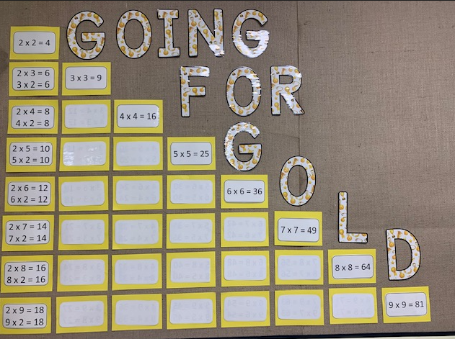
Notes:
There are 21 facts that we look at as focus facts within Going for Gold.

Slide 19
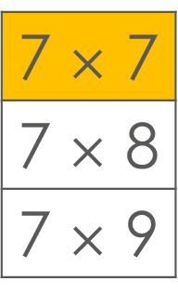
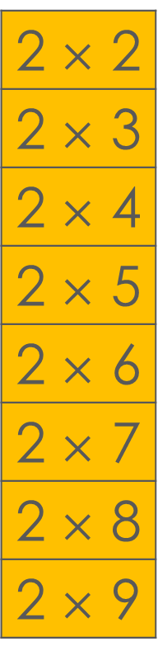
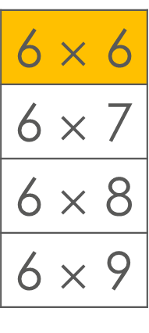
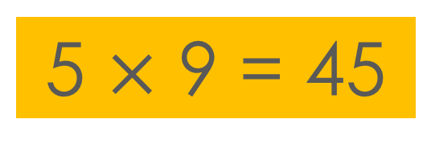
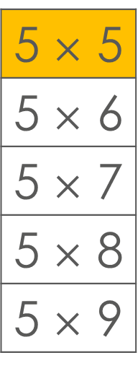
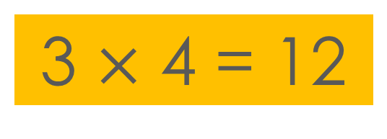
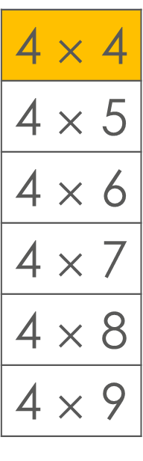
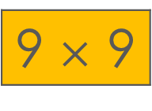
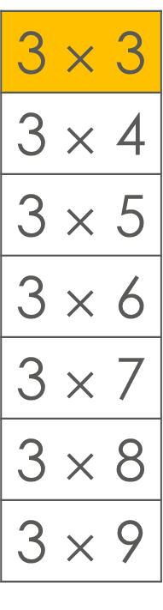
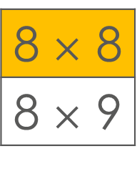
Focus facts of the week
2 $×$ 2
2 $×$ 3
2 $×$ 4
2 $×$ 5
2 $×$ 6
2 $×$ 7
2 $×$ 8
2 $×$ 9
3 $×$ 4 = 12
3 $×$ 3
3 $×$ 4
3 $×$ 5
3 $×$ 6
3 $×$ 7
3 $×$ 8
3 $×$ 9
4 $×$ 4
4 $×$ 5
4 $×$ 6
4 $×$ 7
4 $×$ 8
4 $×$ 9
5 $×$ 9 = 45
5 $×$ 5
5 $×$ 6
5 $×$ 7
5 $×$ 8
5 $×$ 9
6 $×$ 6
6 $×$ 7
6 $×$ 8
6 $×$ 9
7 $×$ 7
7 $×$ 8
7 $×$ 9
8 $×$ 8
8 $×$ 9
9 $×$ 9
Notes:
Only two facts are looked at each week. See the information sheet to see when and which facts are the focus facts

Slide 20
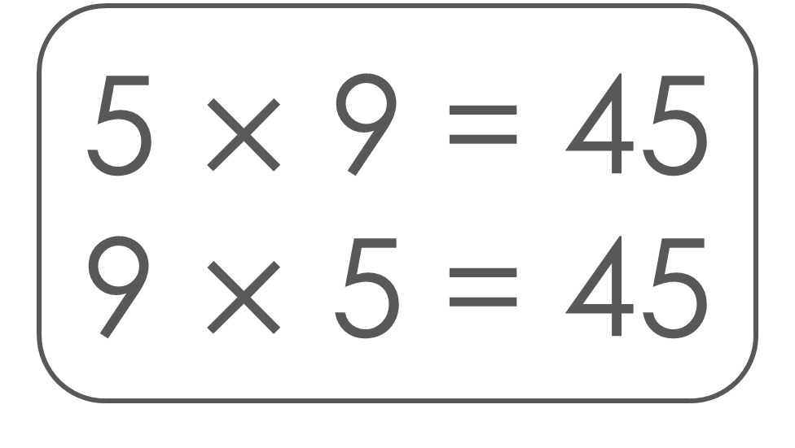
GOING FOR GOLD
Focus fact
5 $×$ 9 = 45
9 $×$ 5 = 45
Focus fact

Slide 21
Understand
Notes:
We make sure pupils understand the relationship between the factors and the product. The programme is not just about retrieval of facts but in understanding the multiplicative relationship.

Slide 22
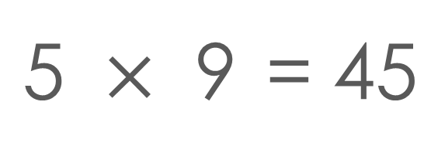
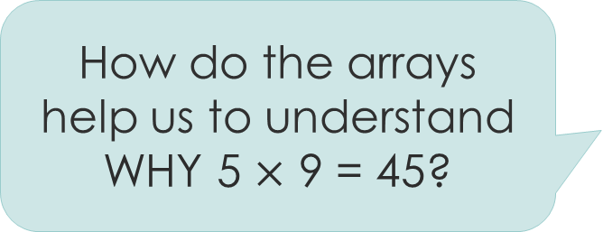
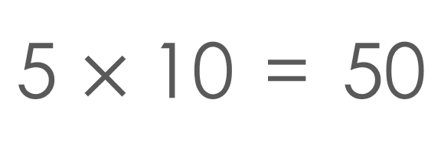
10
How do the arrays help us to understand WHY 5 $×$ 9 = 45?
50
5
5 | $×$ | 10 | = | 50
9
45
5
5 | $×$ | 9 | = | 45
Notes:
We use representations to support pupils to see the maths.

Slide 23
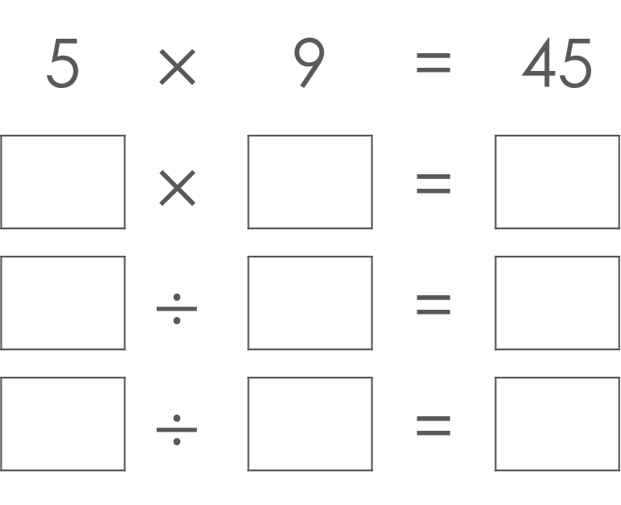
What other facts can Cal write using the same numbers?
5 | $$×$$ | 9 | = | 45
 | $$×$$ |  | =
 | $$÷$$ |  | =
 | $$÷$$ |  | =
9
5
45
45
5
9
45
9
5
Notes:
We ask pupils to write expressions an equations to make sense of the numbers.

Slide 24
Explain

Slide 25
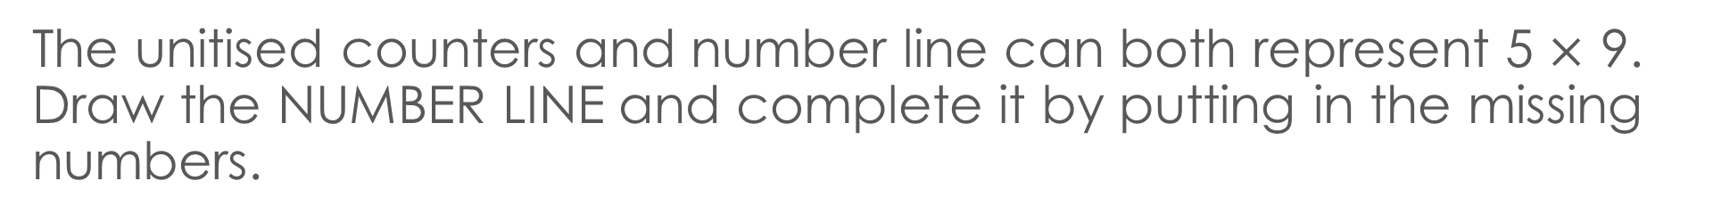
The unitised counters and number line can both represent 5 $×$ 9.
Draw the NUMBER LINE and complete it by putting in the missing numbers.
Explain to a partner how the number line is connected to the unitised counters. Use a gesture to help you explain.
5
5
5
5
5
5
5
5
5
5
0
45
50
Notes:
We learn maths by reasoning – we encourage lots of talk in our sessions.

Slide 26
Say

Slide 27
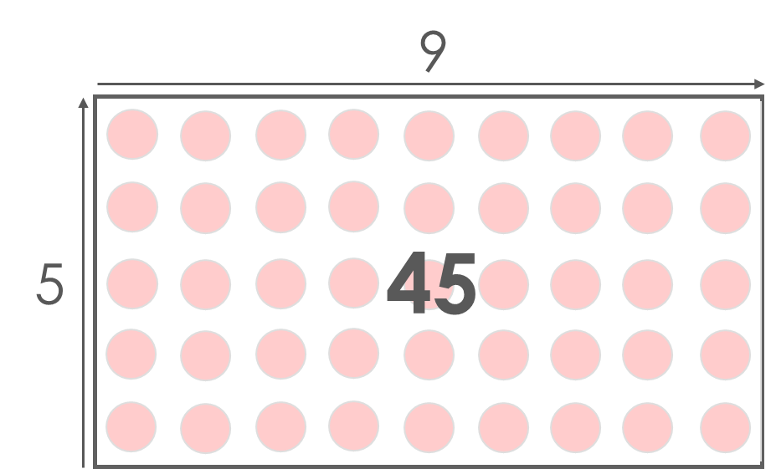


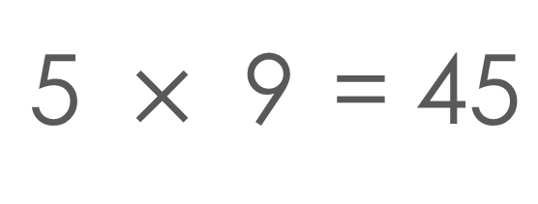
Let’s practise saying ‘5, 9, 45’ twice as we see each picture!
We can use our gestures, or tap for each picture or expression.
Cal
Mo
5 $×$ 9
9 $×$ 5
5
5
5
5
5
5
5
5
5
5
0
45
5 | $×$ | 9 | = | 45
Notes:
We use gestures to support us to remember the facts. You might want to engage the adults in using gestures for this fact.

Slide 28
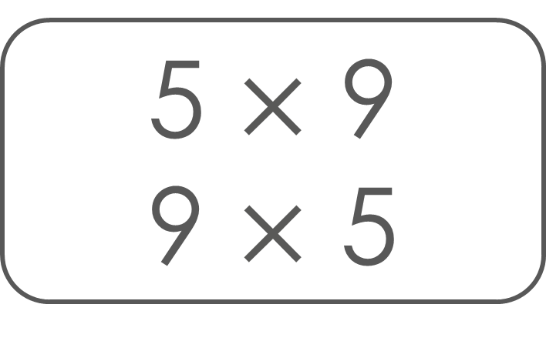
Cards
Say ‘5, 9, 45’ whichever order the factors are written in.
If you don’t know the product, just look at the back of the card and practise saying ‘5, 9, 45’ three times!
Cal
Mo
5 $×$ 9
9 $×$ 5
45

Slide 29
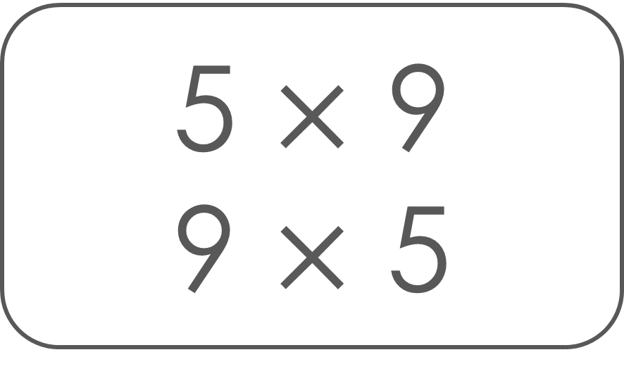
Say ‘5, 9, 45’ whichever order the factors are written in.
Mo
5 $×$ 9
9 $×$ 5
Focus fact
45
Focus fact

Slide 30
Let’s see some Year 4 pupils at the end of the programme
Year 4 pupils using ‘Going for Gold’ cards on Vimeo

Slide 31
Thank you for your support!

